Slide 1
NFC Antenna
Joaquin Sabin, Dylan Robens, Alex Schroeder, Austin Weber

Slide 2
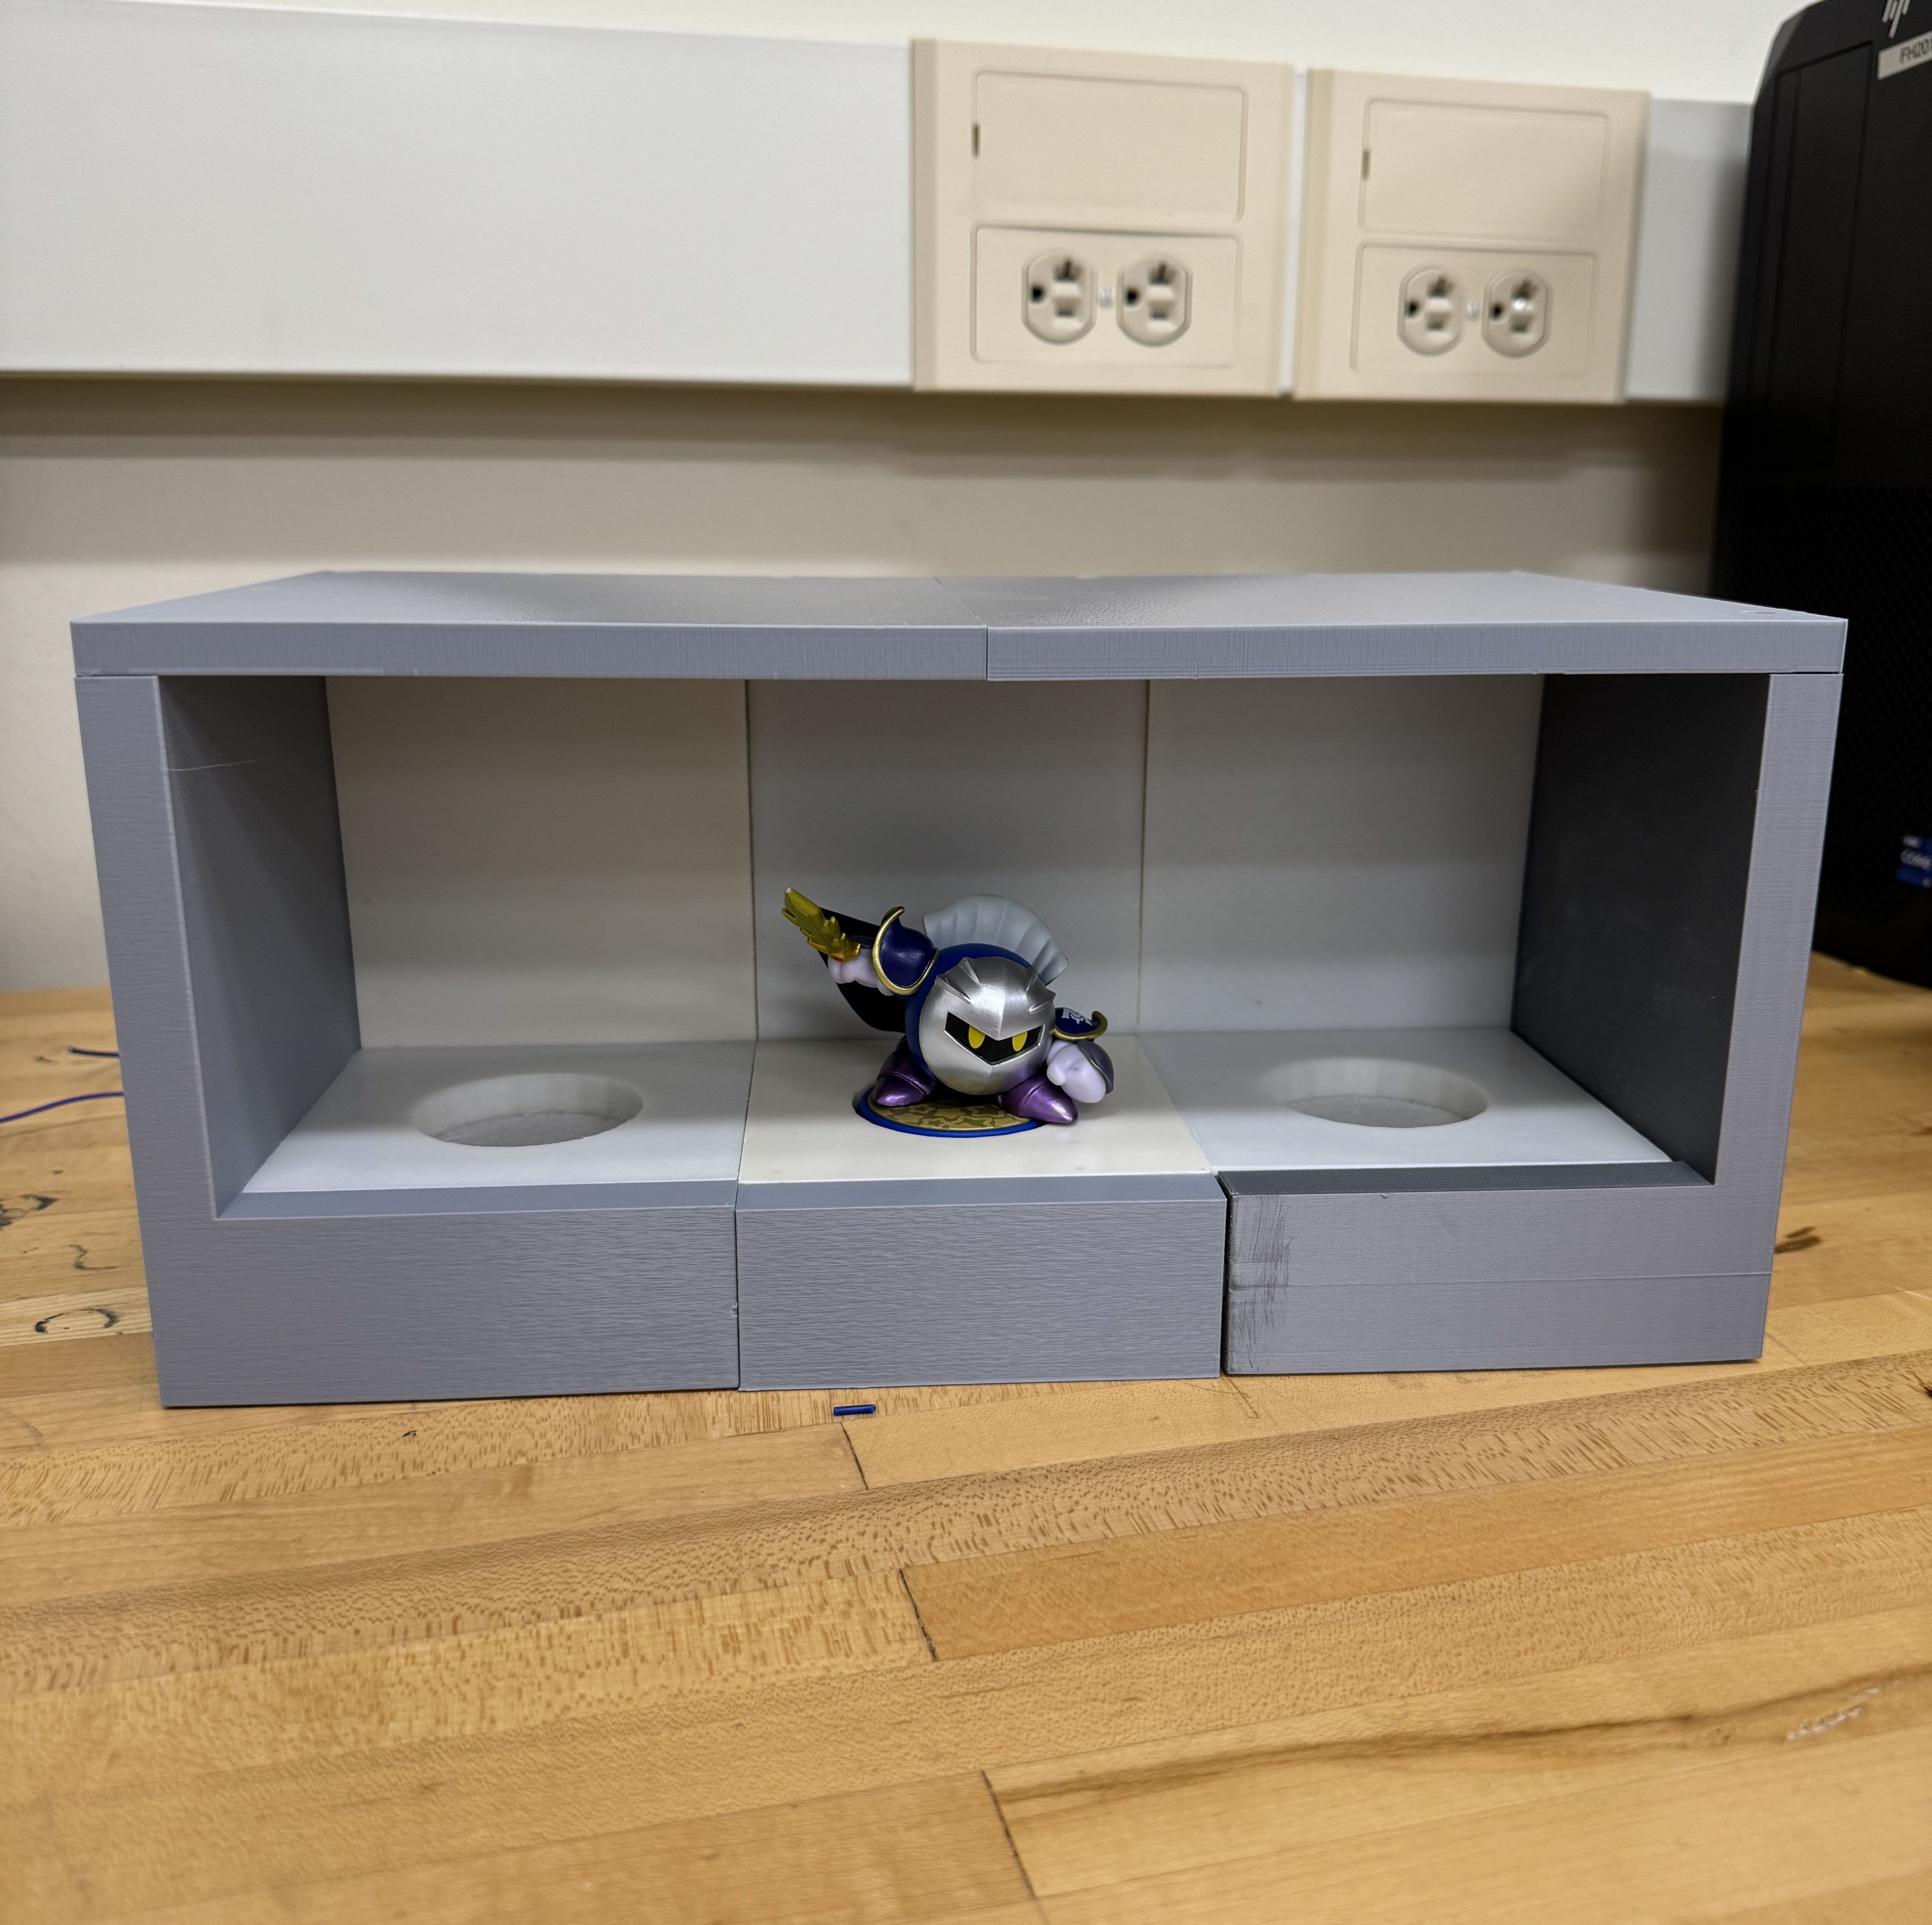
Background
Wanted to create a display shelf for Amiibo figures with custom NFC Antenna PCB boards
Shelf interacts with the NFC chip inside the figures
Created a custom PCB which controls and handles all data
Notes:
Austin

Slide 3

Objective
Custom NFC Board with 5cm Range
Modular Power
Showcase effective data communication through LED and eventually other means
Why Amiibo?
Notes:
Dylan
The goal of this project is to create a custom NFC antenna that can communicate effectively from a larger distance than normal NFC antennas do (targeting 5 cm)
We also want to create a modular power sharing system
Currently we are showing effective data communication through Amiibo's and lighting up LEDs according to which Amiibo was scanned. With modularity we hope to showcase multiple boards communicating effectively
We are using Amiibo as we do not want to break the law by using Stout IDs, home security IDs, or credit cards as the information on these chips should not be publicly accessible or usable by students unless we are looking to get a felony right out of college.

Slide 4
Progress & What We’ve Accomplished So Far
Made calculations, designed, and fabricated an NFC antenna
Designed and fabricated a motherboard PCB to process all data
Designed and 3D printed a model that successfully houses the antennas, sensors, and NTAG chips while being compact
Programmed all data handling to communicate with Amiibo figures
Notes:
Austin

Slide 5
What's left to do
Testing our Custom NFC Antenna
Final Report
IEEE Presentation
Redesign 3D model to be more compact & effective
Set up power modularity
Set up data transfer with modularity (If time permits)
Notes:
Joaquin

Slide 6
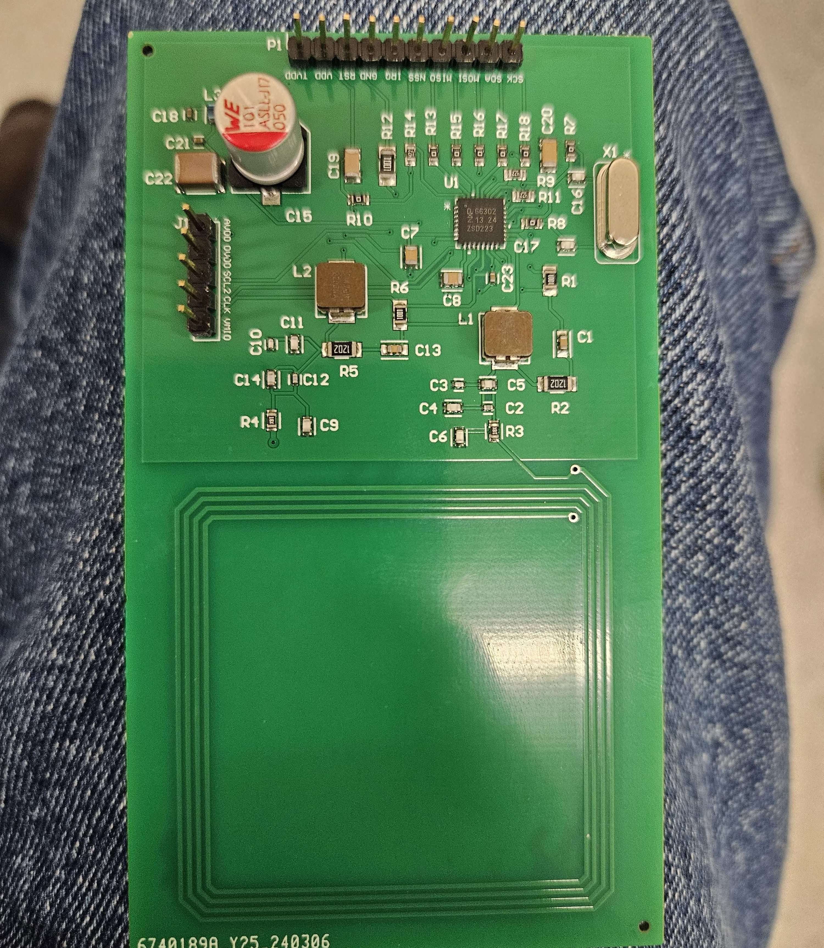
NFC Antenna
Culmination of Semester 1 work
Looked into how to achieve 5cm
Simulations showcase it working
Debugging
Notes:
Alex (Dylan)
Calculating and designing this board is what took up the majority of our first semester.
We performed many calculations and eventually figured out the values that our components would need to be to effectively communicate at a distance.
According to simulations based off the NFC antenna circuit we created we know our antenna mathematically works.
Debugging the board is currently being done to see why our program isn’t working.

Slide 7
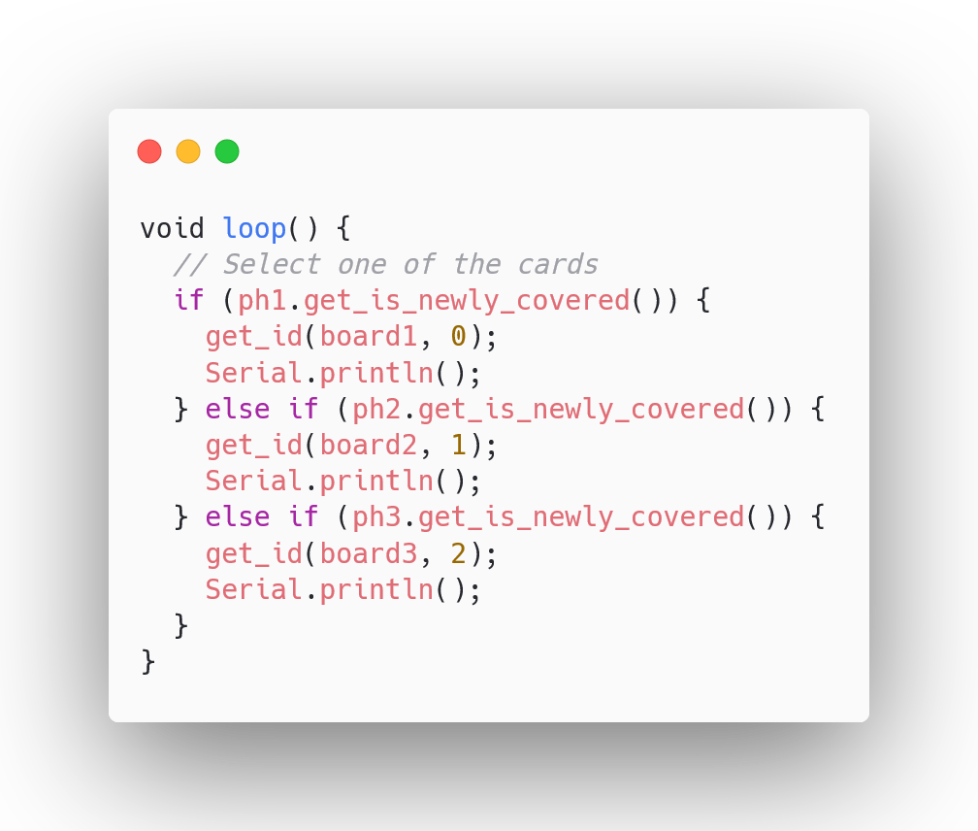
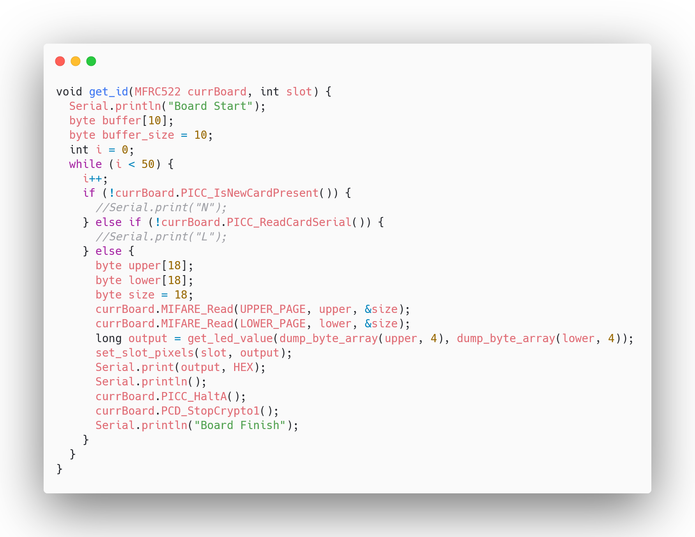
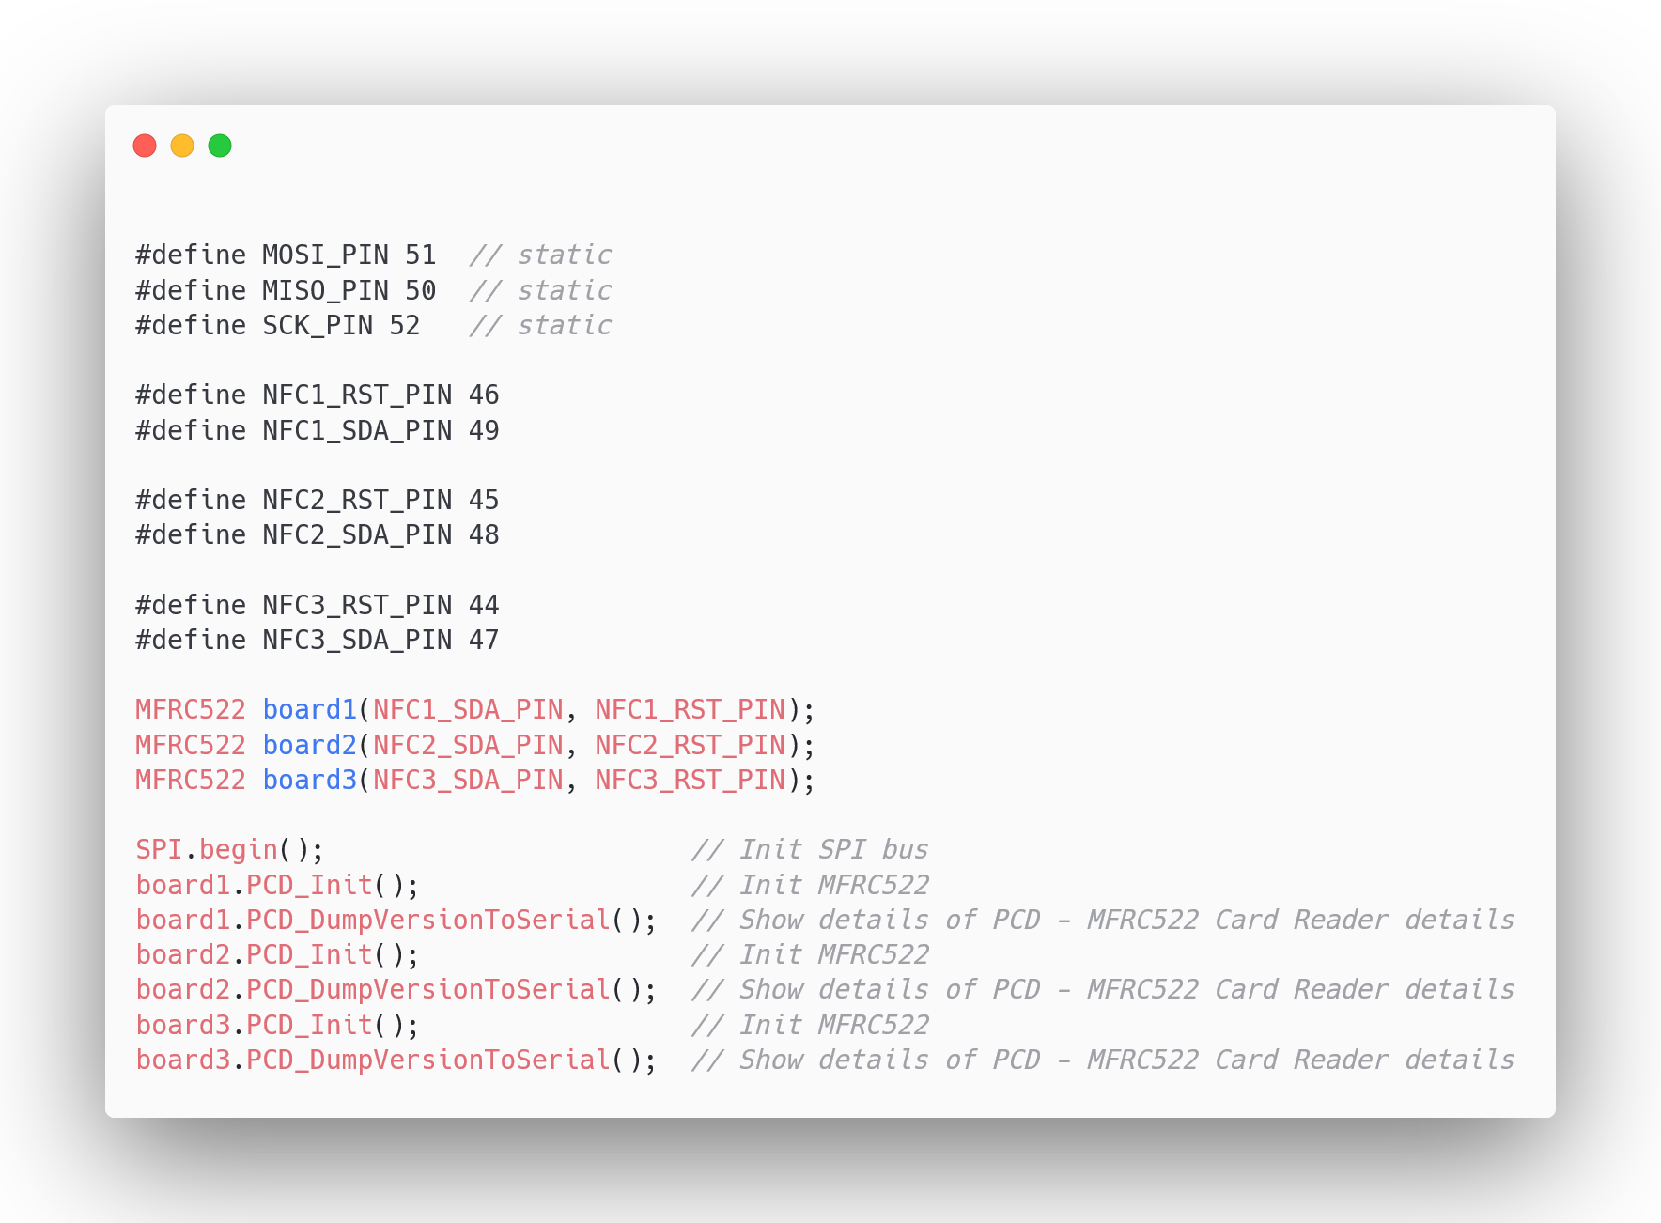
Programming – NFC Board
CLRC663 vs MFRC522
Reading the data (Pages 21 and 22)
Notes:
Austin

Slide 8
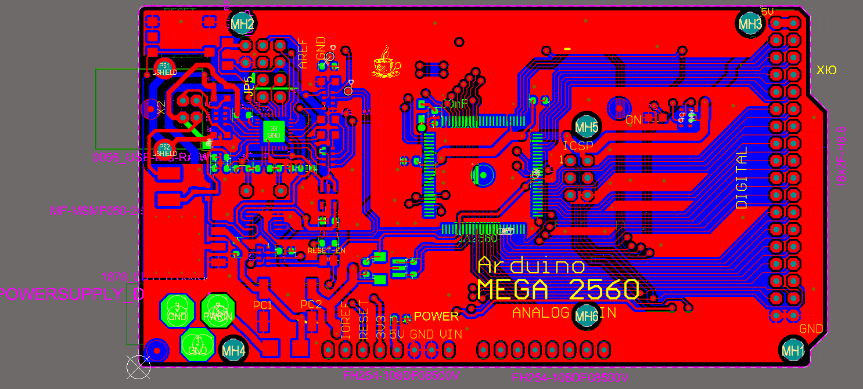
Custom Motherboard PCB
On order from JLCPCB currently
Will handle all the data communication and process all functions of the shelf
Uses AT-Mega chip
Notes:
Alex (Austin)

Slide 9
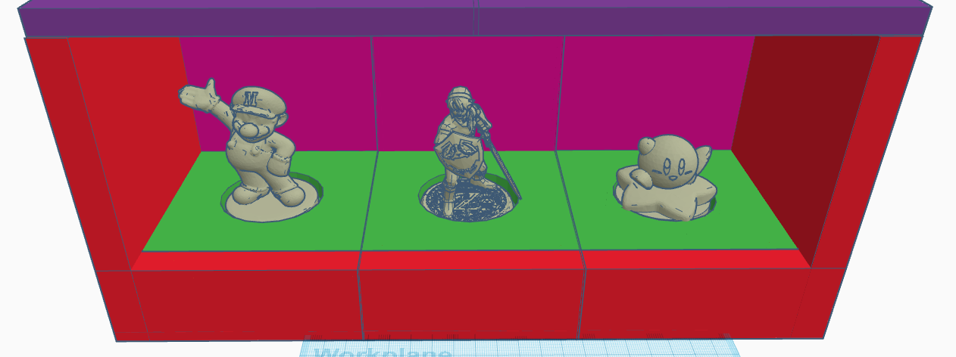
3D Model
We used CAD to create a custom housing for the antenna to internally be held and effectively communicate with the Amiibo
Redesigned for easy assembly so that we access internals in a timely manner.
Working on more redesigns to be more structurally secure
Notes:
Dylan

Slide 10

Struggles we faced along the way
Currently we are struggling getting our custom NFC antenna set up. It uses a different chip and library so we are debugging that
Getting our initial 3D prints working was a challenge as certain overhangs led to a print failure
Due to JLCPCB we experienced a 2 month delay on both our boards arriving meaning we have only recently been able to start testing the NFC Board. We are still waiting for our motherboards to arrive.
Ordering the JLCPCB boards was also a struggle as parts that we needed kept going out of stock and we needed to order nearly all our parts in prior to the PCBs being made
Notes:
Joaquin

Slide 11
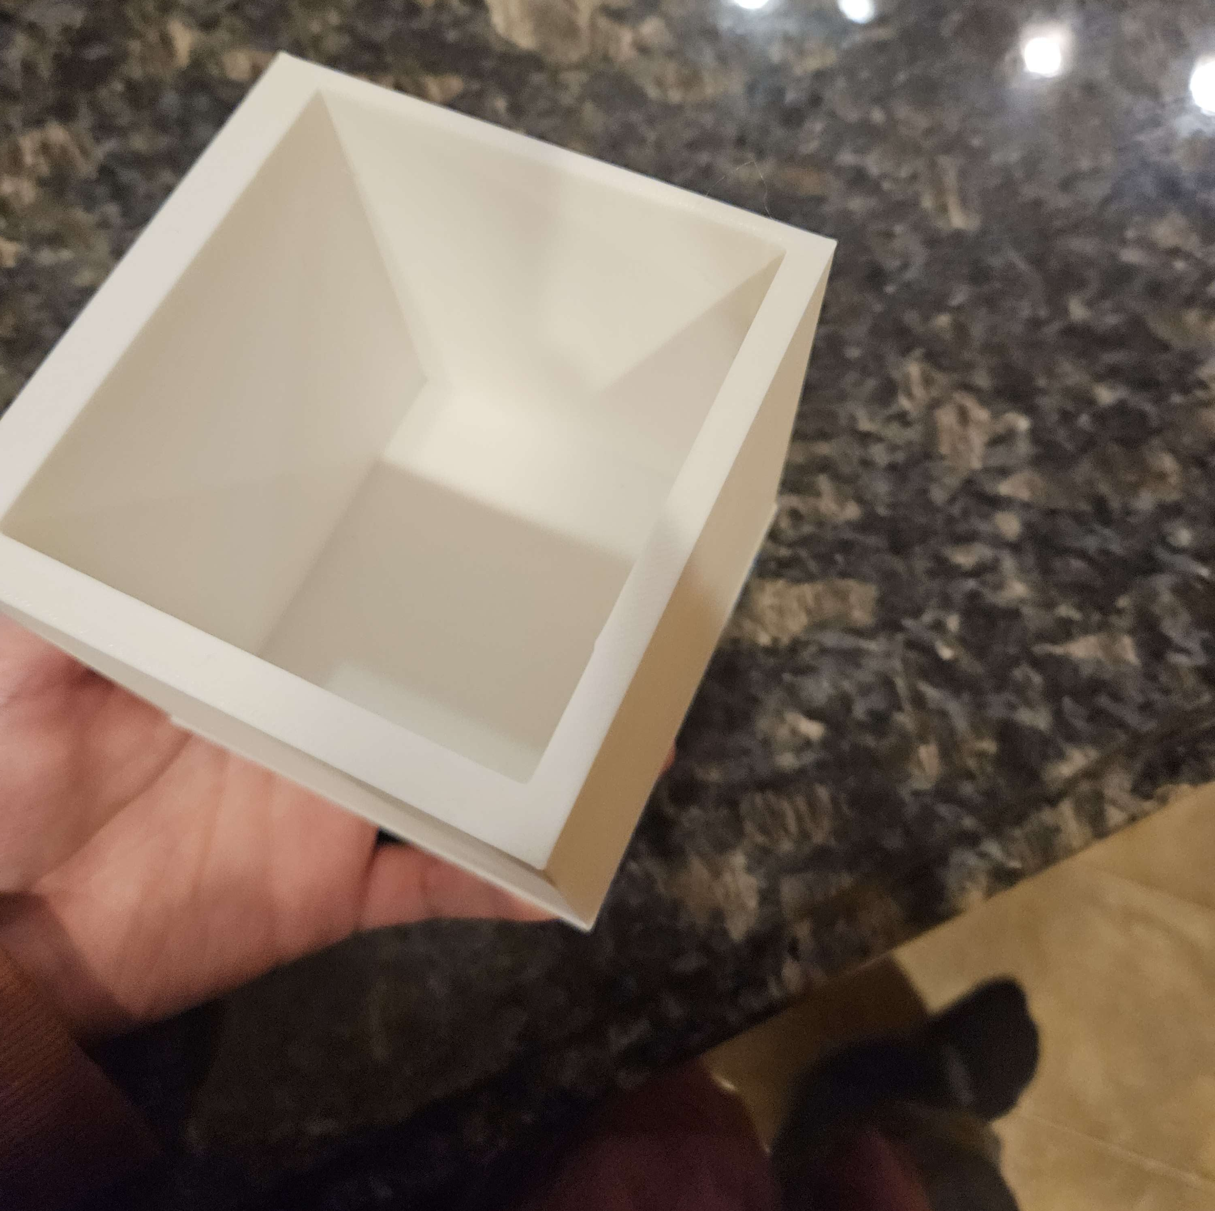
Tests/Debugging – LED placement
We tested different thicknesses of the PLA that would allow light to pass through effectively
We tested different distances to place the LEDs to ensure no blooming
Notes:
Alex (Joaquin)

Slide 12
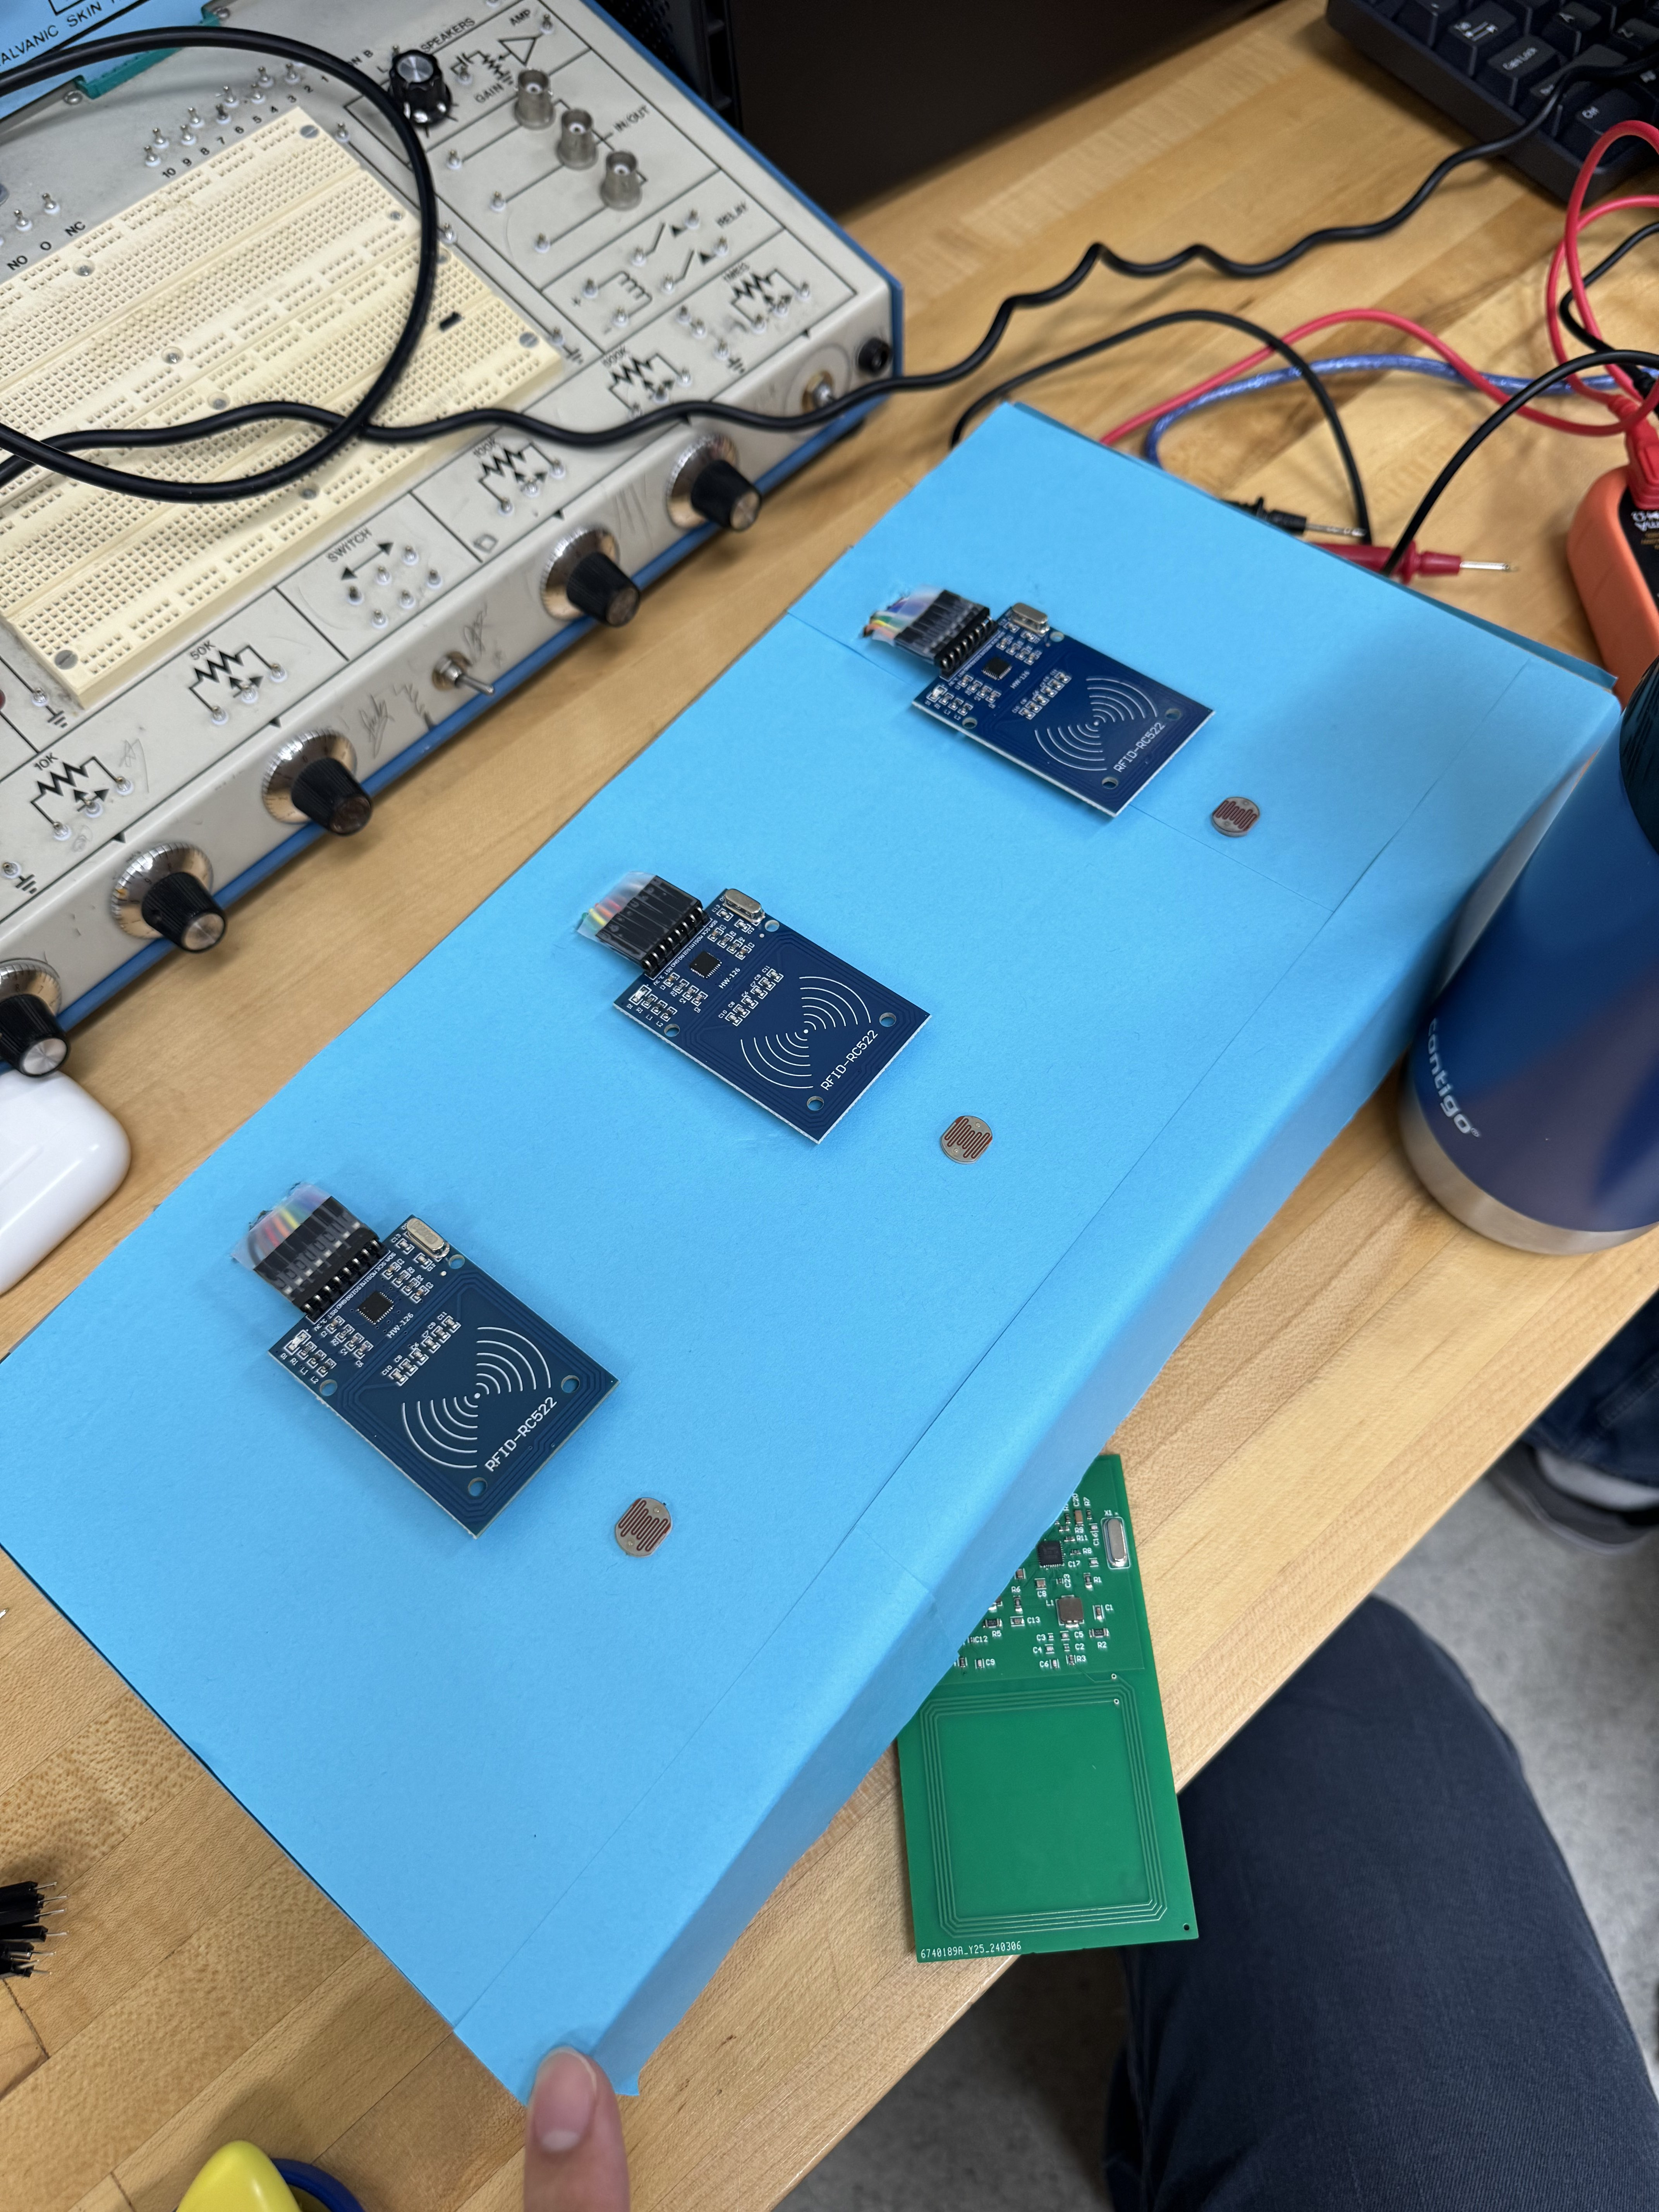
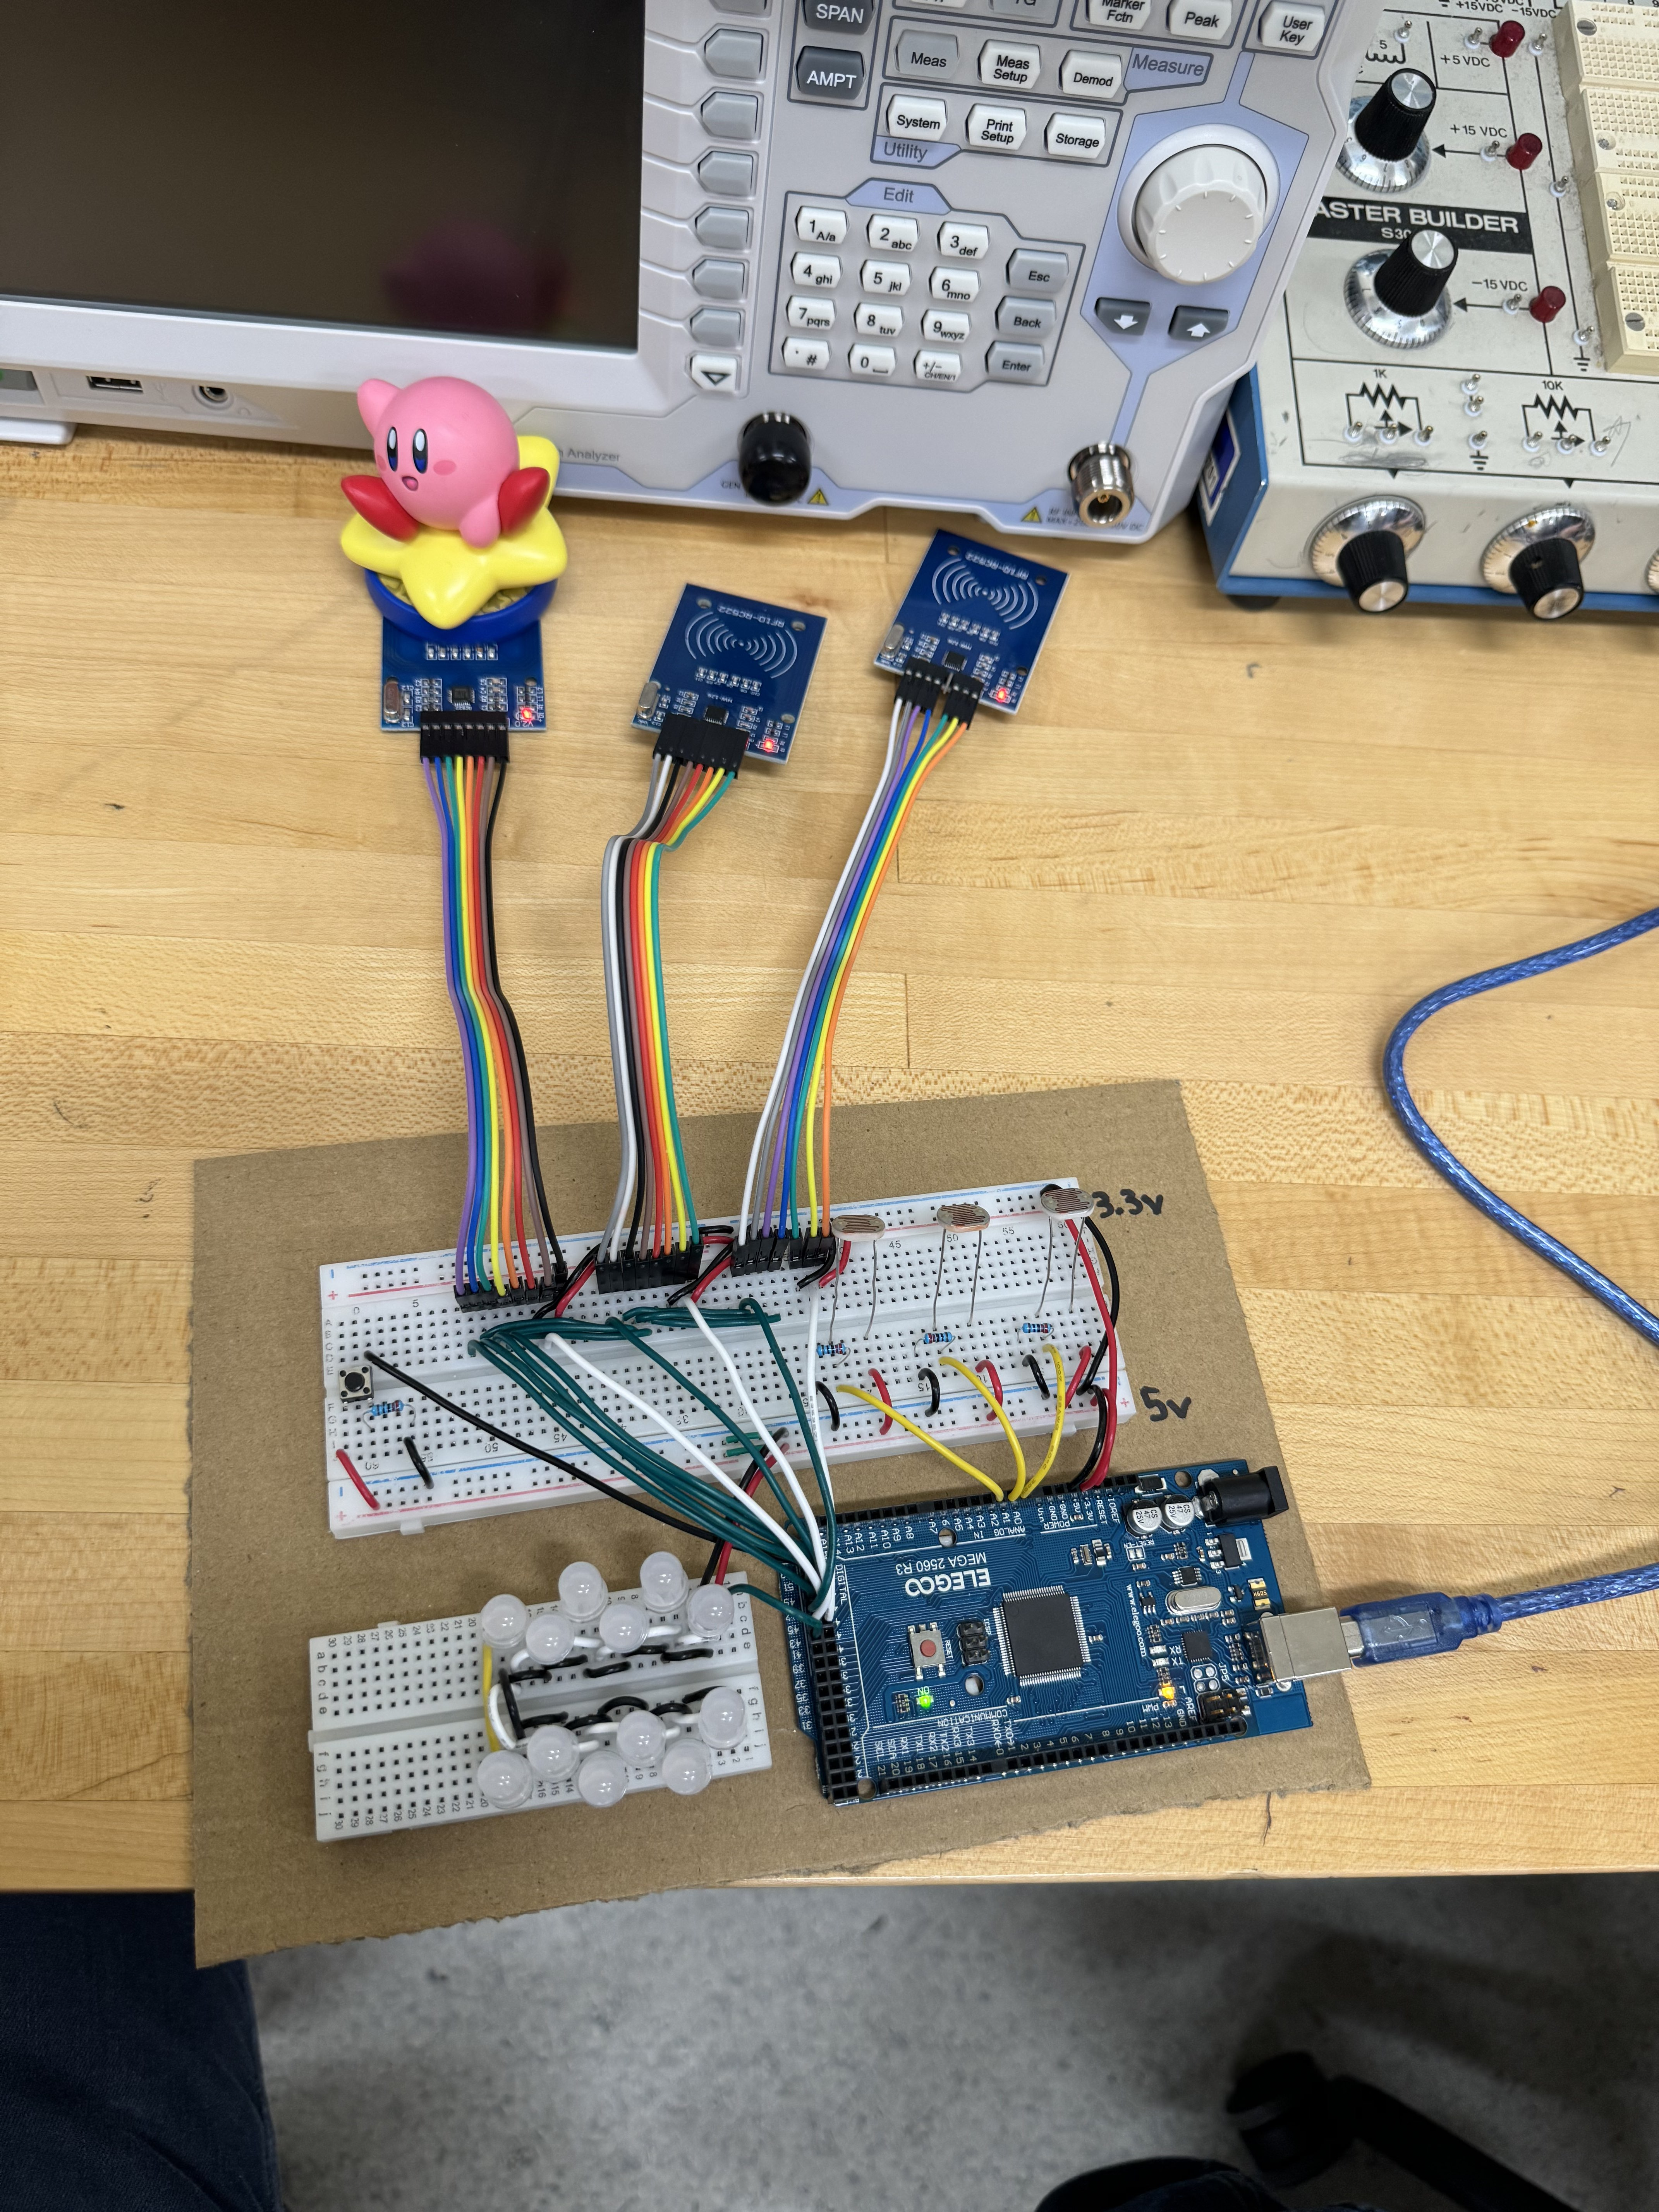
Tests/Debugging – Cardboard Prototype
While waiting on our PCBs to arrive and 3D models to print, we created a prototype out of cardboard to begin coding and ensure the concept works
Notes:
Joaquin

Slide 13
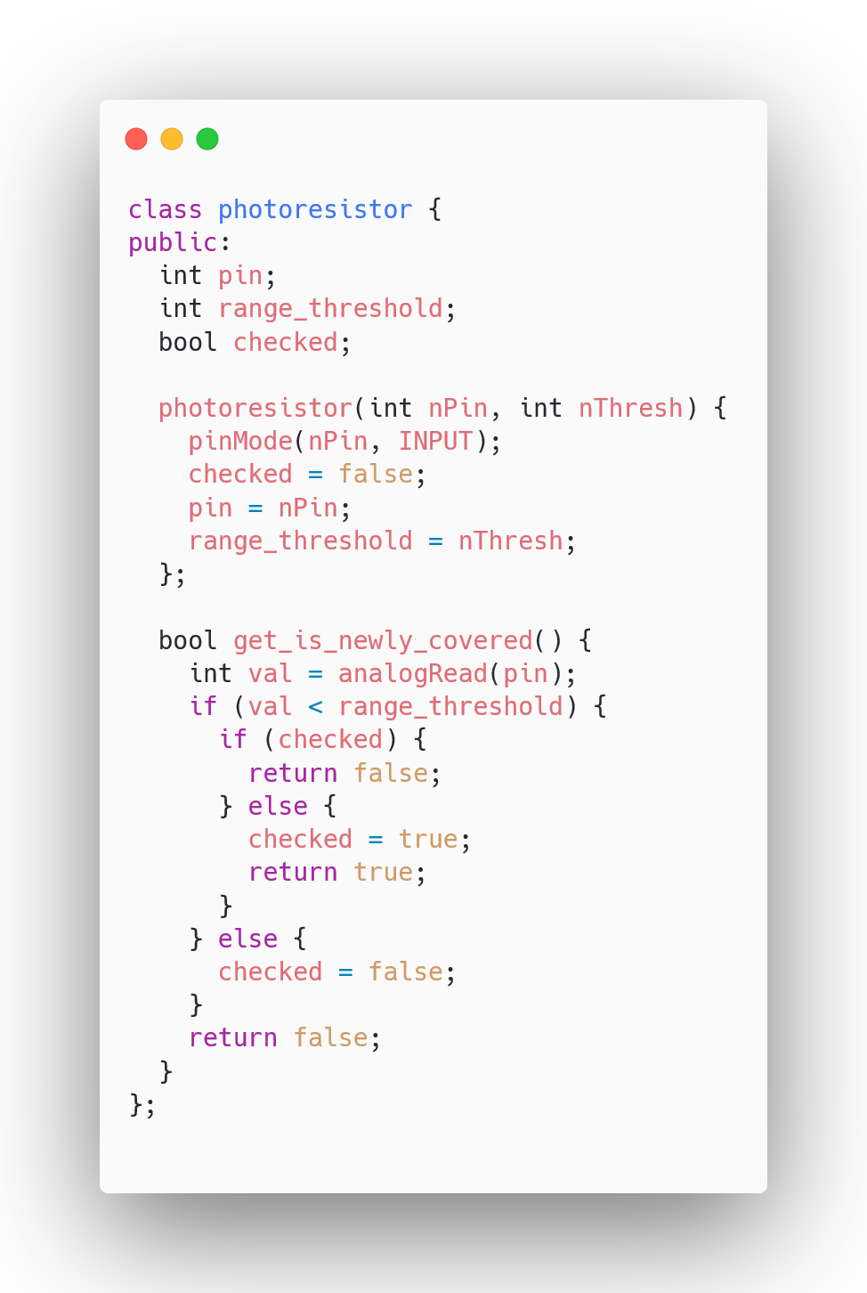
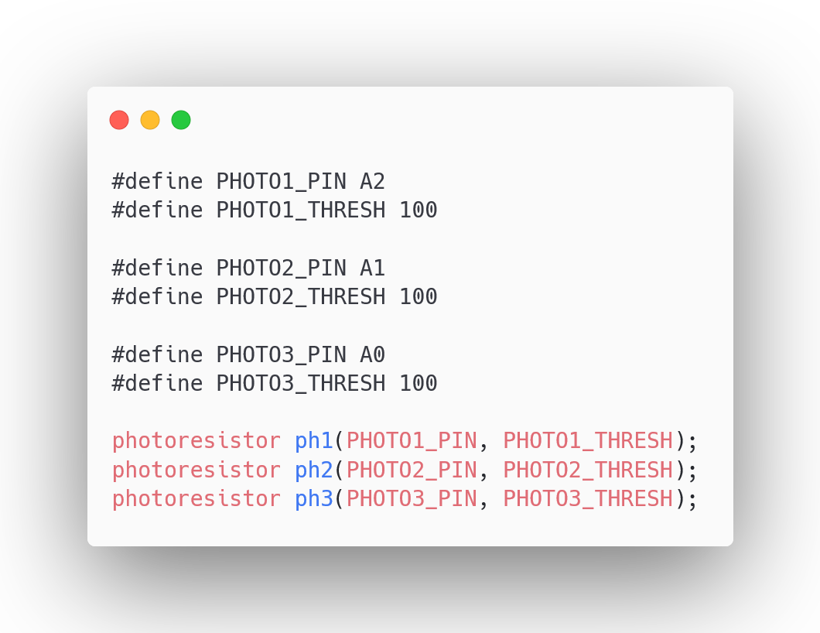
Programming - Photoresistors
Notes:
Austin

Slide 14
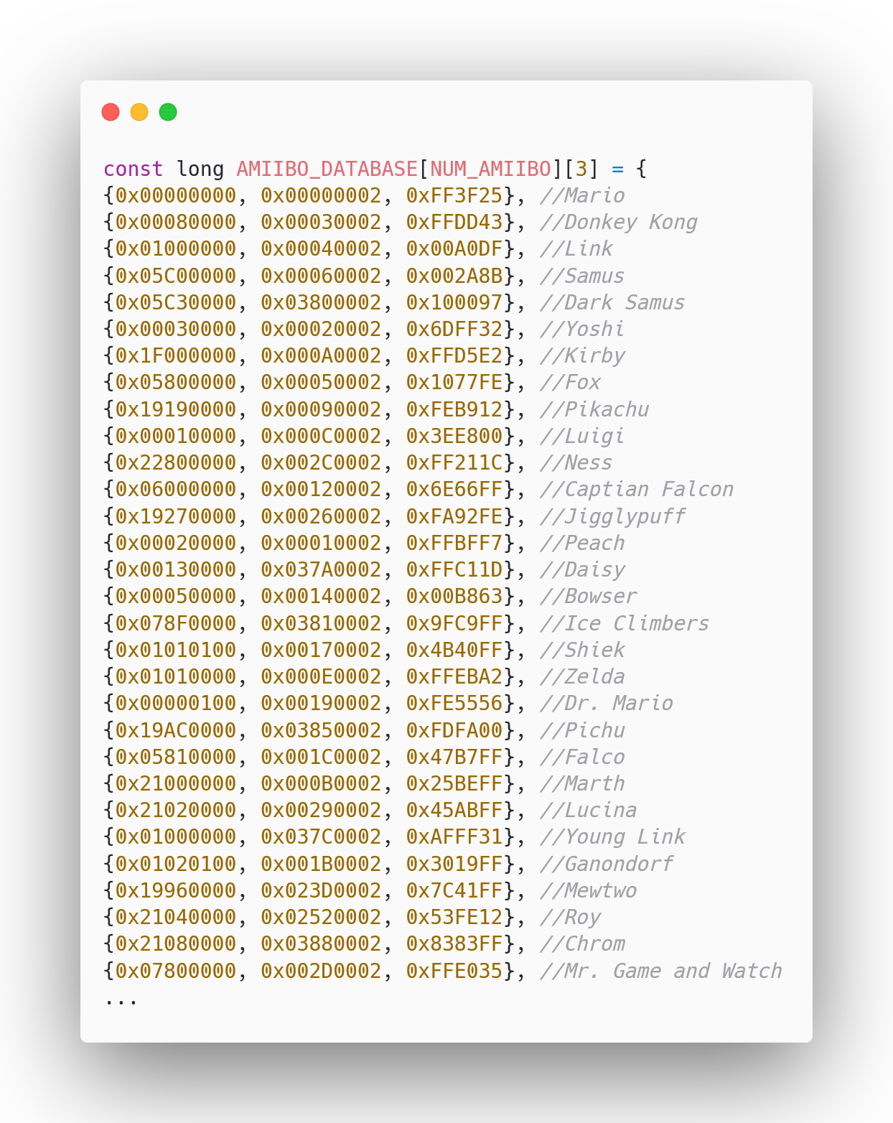
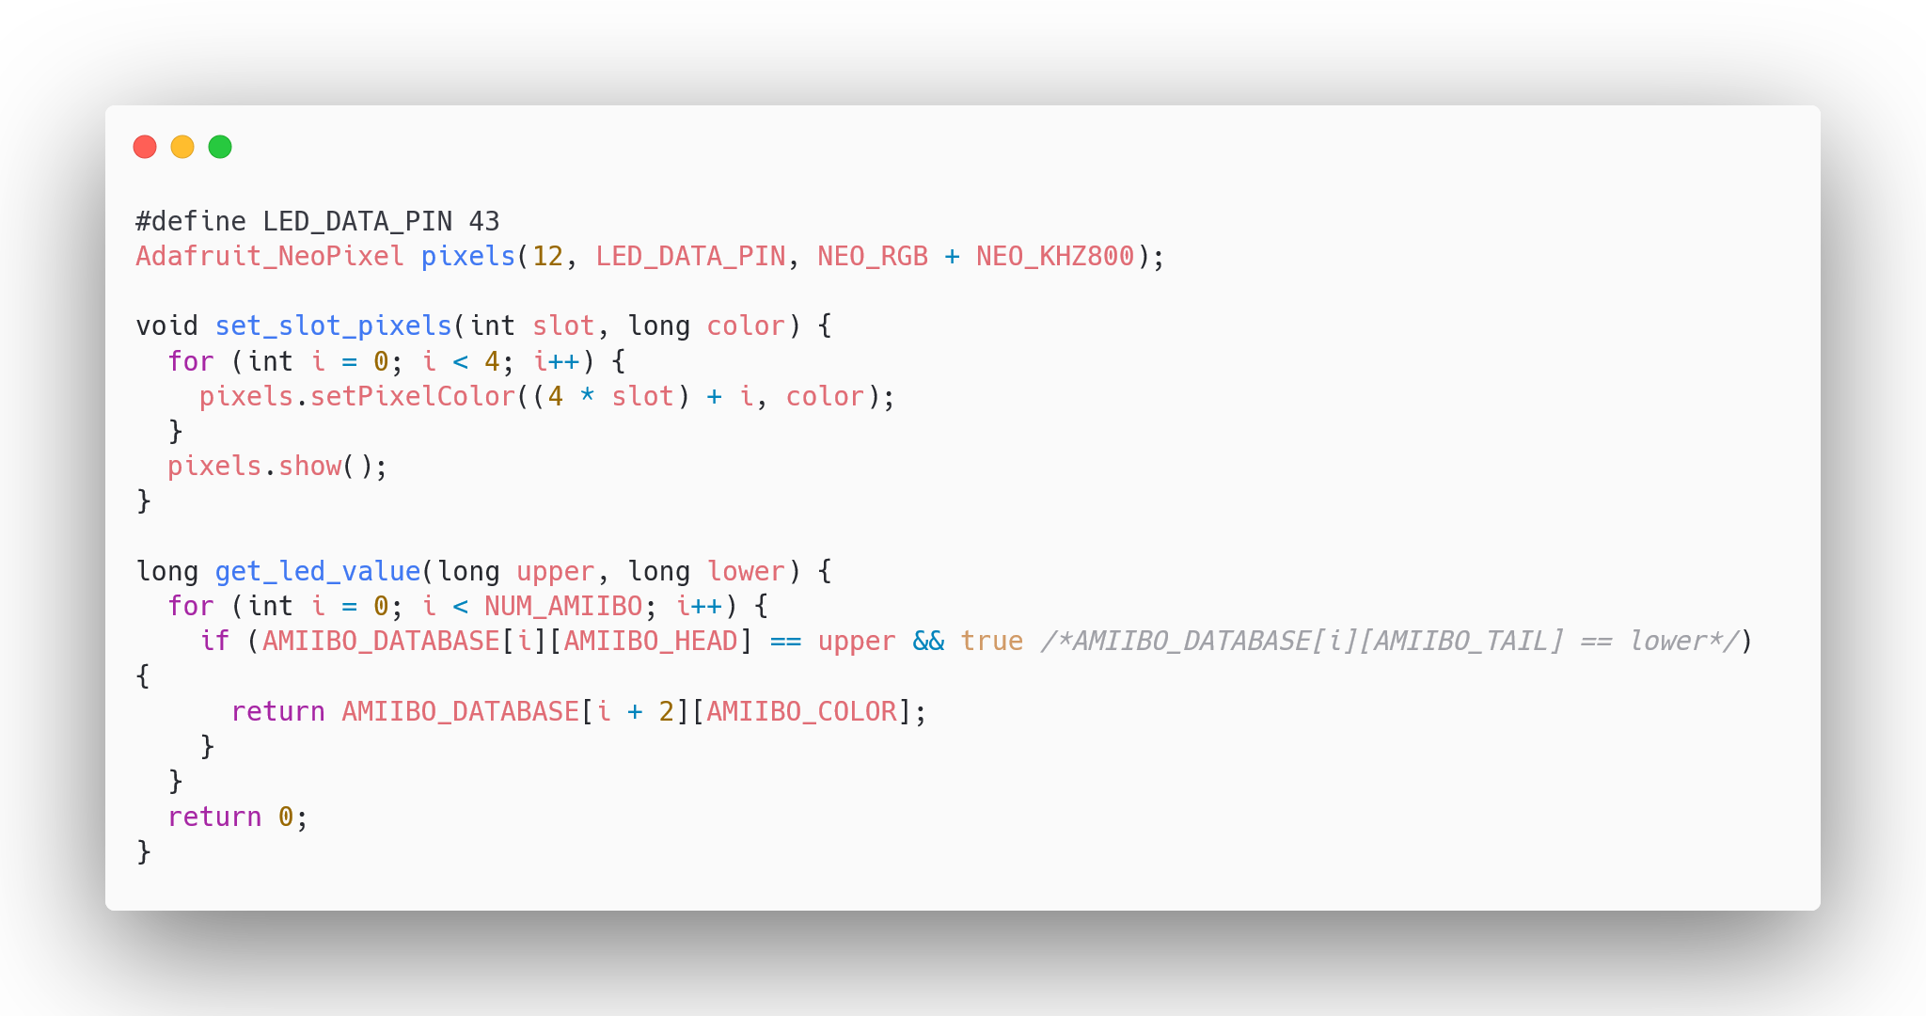
Programming - COM-12877 LEDs
Notes:
Austin

Slide 15
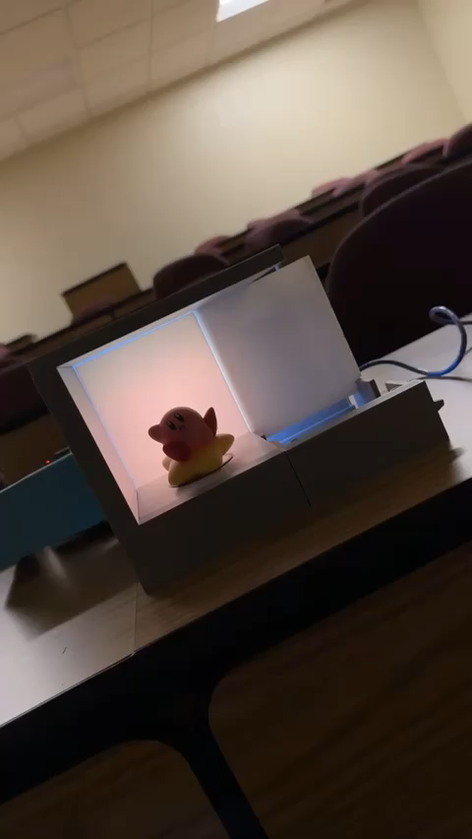
Working Prototype Demonstration
Notes:
Joaquin

Slide 16
Timeline
Over the next 2 weeks we plan to…
Test and verify the NFC Antenna is communicating
Finish our IEEE paper and presentation (due April 12th)
3D print, assemble, and wire the rest of our shelves
Iron out any programming issues
Start to implement data modularity if time permits
Notes:
Alex

Slide 17

Show Physical Shelf
Questions?
Notes:
Dylan

